Slide 1

Efficient Home Insulation:
Reduce Energy Bills
and Carbon Footprint
By Team 11

Slide 2
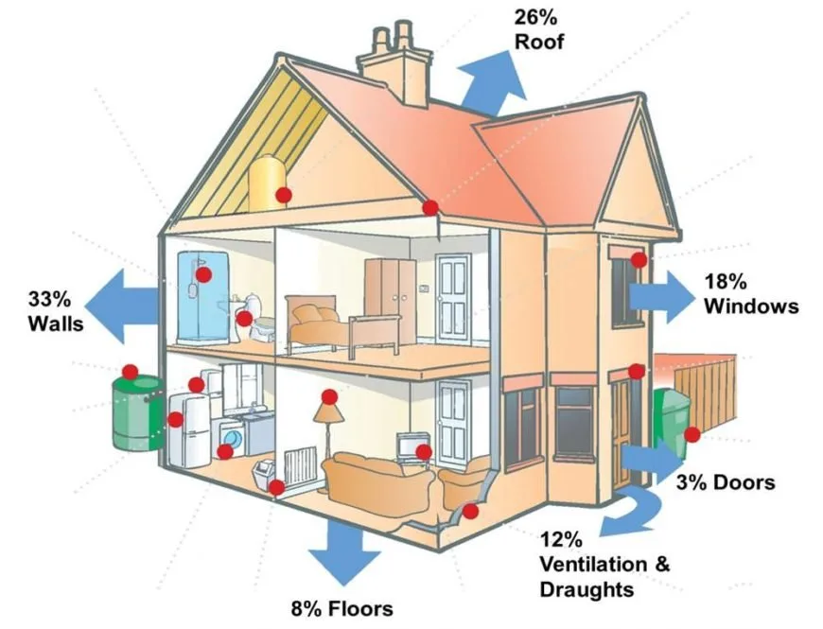
Looking to insulating your home?
Here is what you should know
Ref: Homestratosphere's Editorial Staff & Writers, “4 types of insulation for Your House (Pros & Cons),” Home Stratosphere, Nov. 02, 2022, https://www.homestratosphere.com/types-of-insulation-for-your-house [accessed: Mar. 23, 2023].

Slide 3

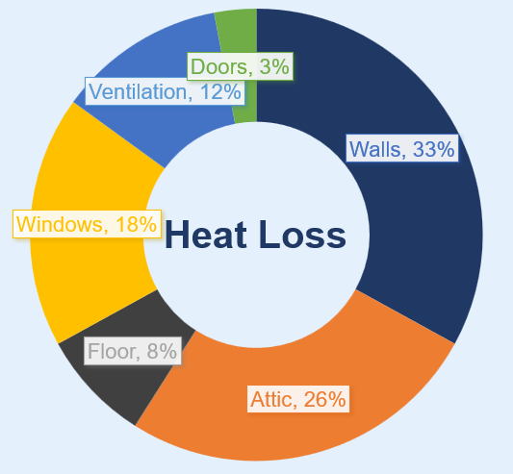
Ref: Home stratosphere's Editorial Staff & Writers, “4 types of insulation for Your House (Pros & Cons),” Home Stratosphere, Nov. 02, 2022, https://www.homestratosphere.com/types-of-insulation-for-your-house [accessed: Mar. 23, 2023].

Slide 4
AGENDA
Introduction
Problem Description
Problem Solution
Thermal Resistance
Proposed Materials and Improvements
SDGs
Conclusion

Slide 5
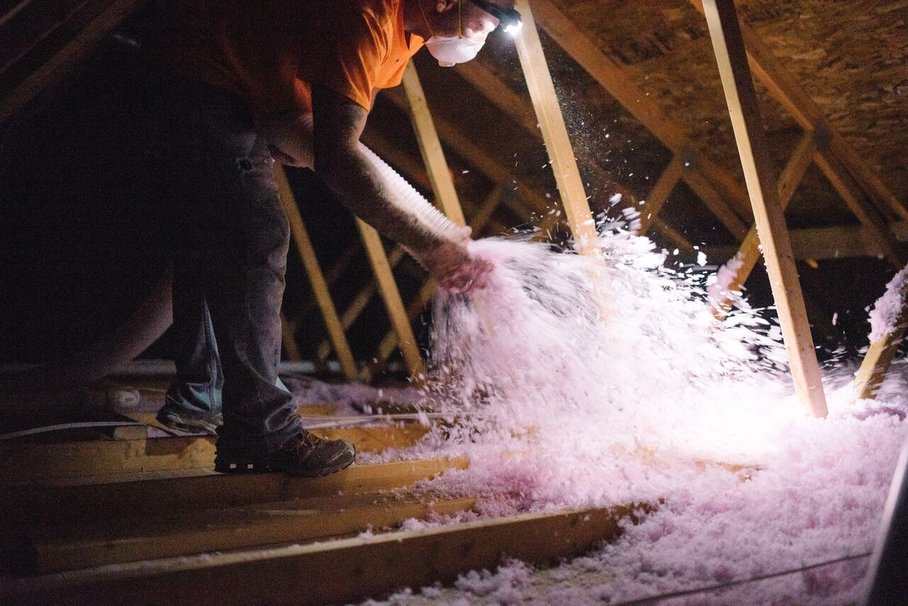
Inefficient home insulation system:
Outdated or poorly installed insulation material
Leads to energy waste
Impact climate change
INTRODUCTION

Slide 6
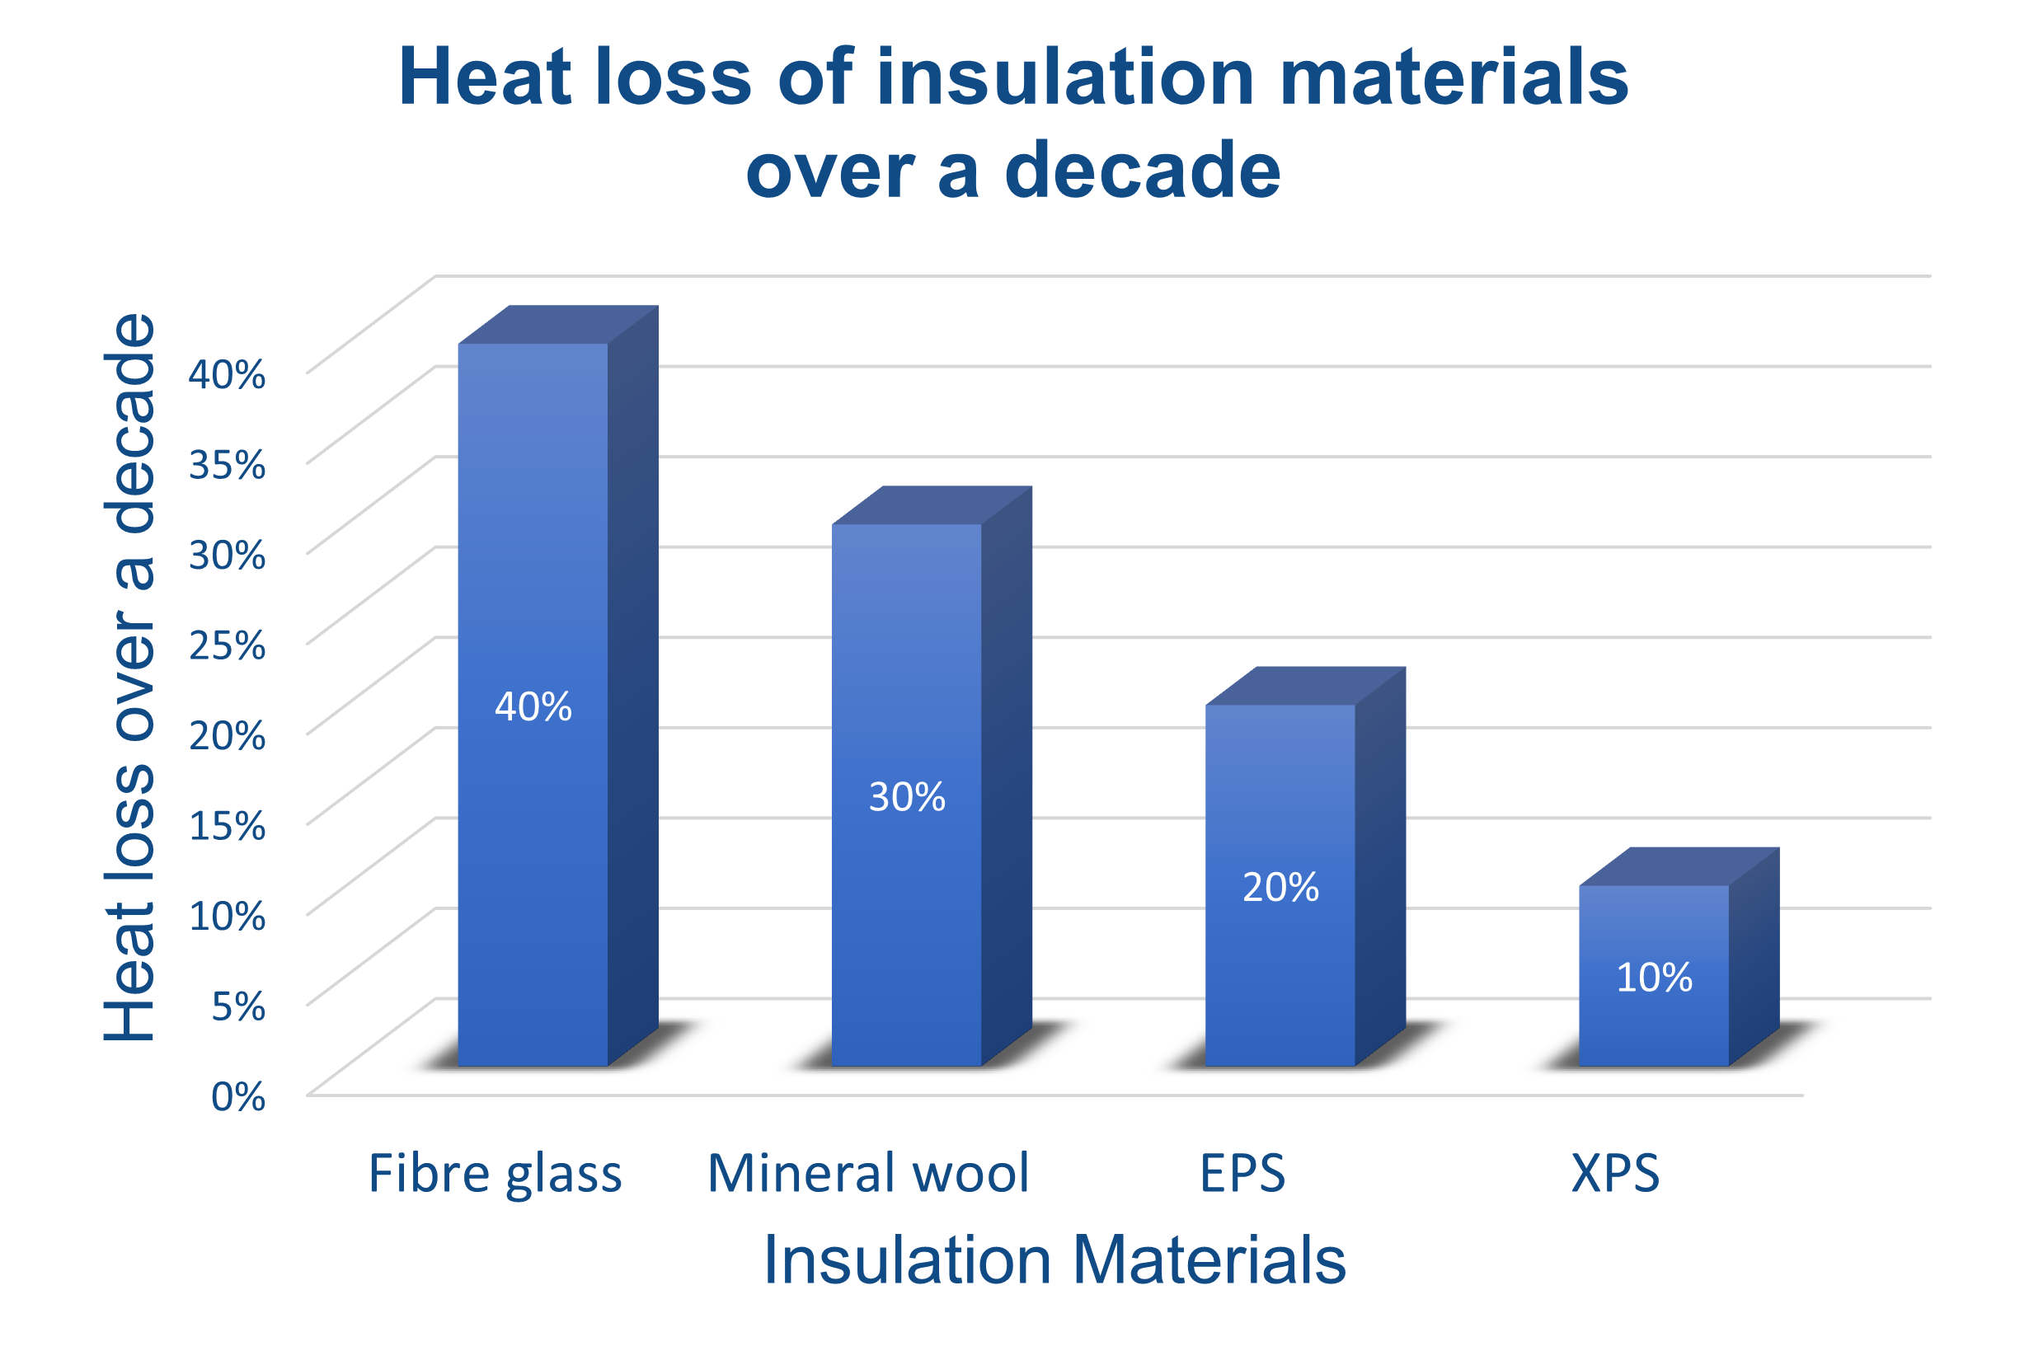
Fiber glass insulation loses 40% heat when exposed to moisture
Mineral wool loses 30% heat due to inadequate installation
Problem Description
Ref: D.-L. Liu and W. W. Nazaroff, “Modeling pollutant penetration across building envelopes,” Atmospheric Environment, vol. 35, no. 26, pp. 4451–4462, Sep. 2001, https://doi.org/10.1016/S1352-2310(01)00218-7 [accessed: Mar. 23, 2023].

Slide 7
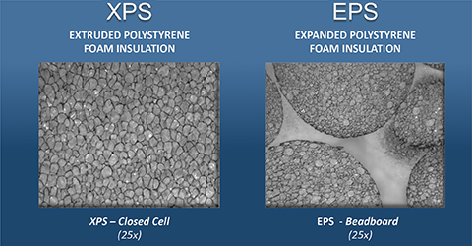
EPS and XPS provides:
more resistant to moisture
more resistant to Air leakage
increases Energy efficiency
Problem Solution
Ref: J. Woestman, “Selecting polystyrene foam where moisture exposure occurs,” Construction Specifier, Dec. 22, 2016, https://www.constructionspecifier.com/selecting-polystyrene-foam-where-moisture-exposure-occurs [accessed: Mar. 23, 2023].

Slide 8
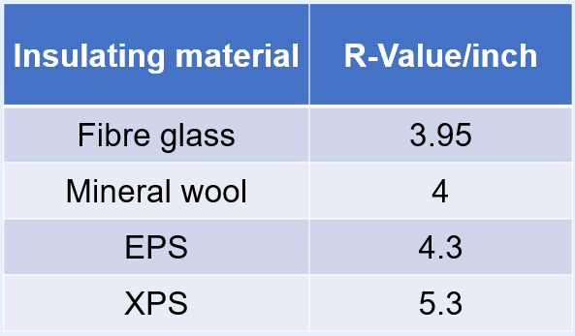
Thermal Resistance
R-value measures insulation material's resistance to heat flow.
Higher R-values provide better insulation and energy efficiency
Proper installation and maintenance of insulation is important for achieving desired R-value and cost savings
Ref: M. Aey, “Types of low-slope roof thermal insulation,” Certified Commercial Property Inspectors Association, Sep. 15, 2020, https://ccpia.org/types-of-low-slope-roof-thermal-insulation [accessed: Mar. 23, 2023].

Slide 9
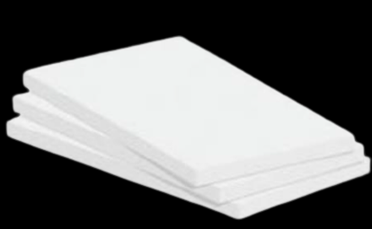
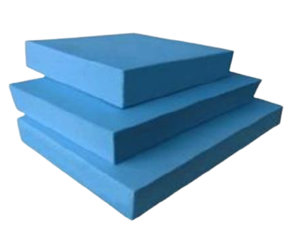
EPS
Excellent thermal insulation
Light weight
Durable
XPS
Moisture resistant
Stable thermal resistivity
Recyclable
EPS :
Expanded Polystyrene
XPS:
Extruded Polystyrene
Proposed Materials
Ref: B. O. Ayegba, K.-J. I. Egbe, A. Matin Nazar, M. Huang, and M. A. Hariri-Ardebili, “Resource efficiency and thermal comfort of 3D printable concrete building envelopes optimized by performance enhancing insulation: A numerical study,” Energies, vol. 15, no. 3, pp. 1–14, 2022. https://doi.org/10.3390/en15031069 [accessed: Mar. 23, 2023].

Slide 10
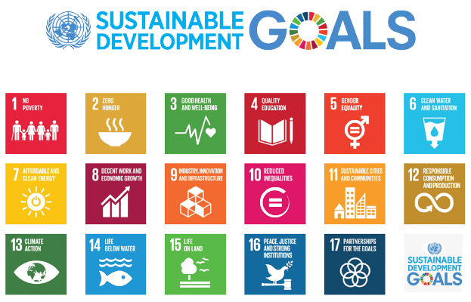
EPS and XPS should be manufactured by recyclable and sustainable materials
Promotes responsible production and reduces waste
Improvements
Ref: United Nations, “How to achieve sustainable development goals,” The Global Goals, Feb. 21, 2022, https://www.globalgoals.org/take-action [accessed: Mar. 23, 2023].

Slide 11

EPS and XPS Addresses:
SDG 7
Energy Efficiency
Renewable Energy
SDG 11
Sustainable Buildings
Waste Reduction
SDG
Ref: United Nations, “United Nations Sustainable Development, https://www.un.org/sustainabledevelopment [accessed: Mar. 23, 2023].

Slide 12
SDG
Cont.
SDG 12
Resource efficiency
Circular economy
SDG 13
Climate Action
Sustainable Consumption
Ref: United Nations, “United Nations Sustainable Development, https://www.un.org/sustainabledevelopment [accessed: Mar. 23, 2023].

Slide 13
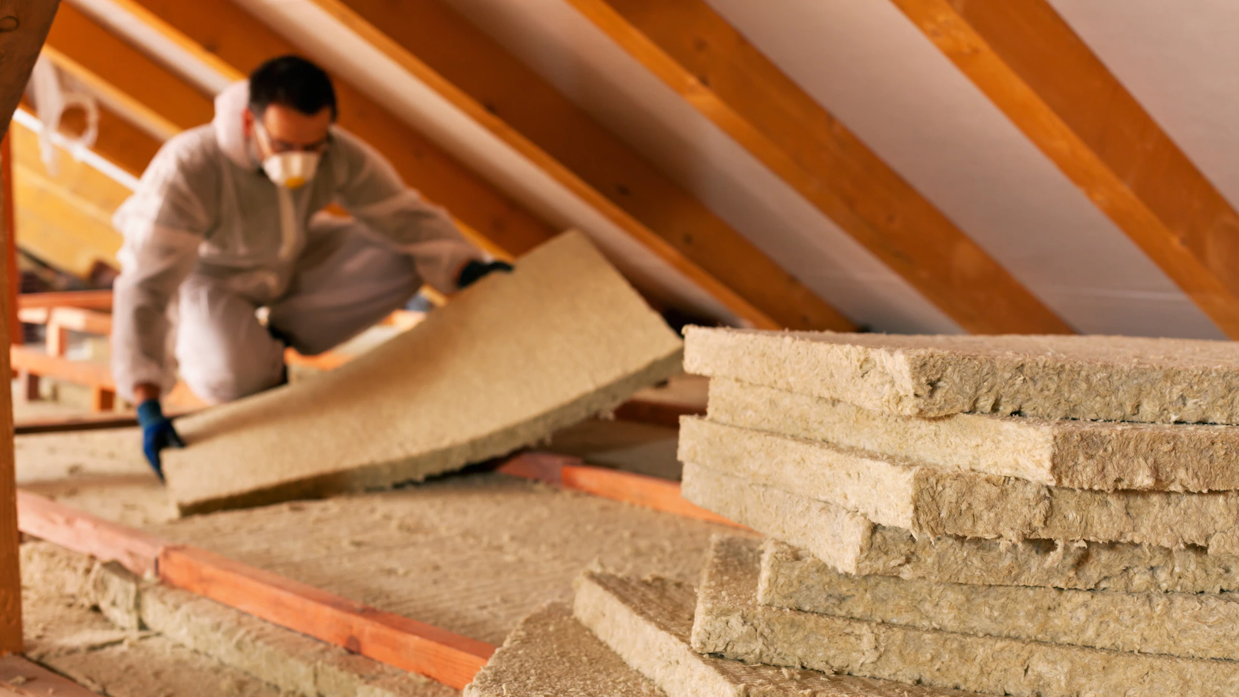
In conclusion, insulation material plays a vital role in building a more sustainable future and:
helps reduce energy consumption.
improves indoor air quality.
Conclusion

Slide 14
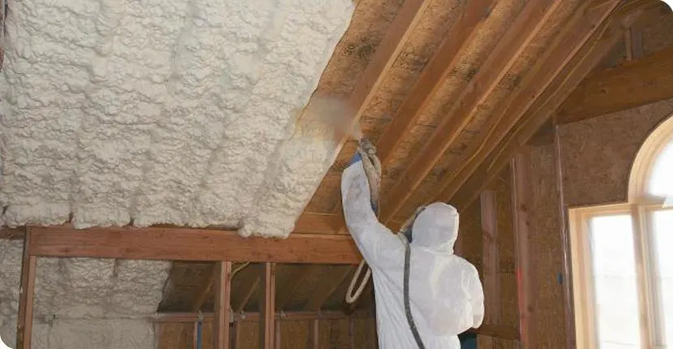
Thank you

